Slide 1
TAGS AND ATTRIBUTES
1. HTML attributes provide additional information about HTML elements.
2. Attributes usually come in name/value pairs like: name="value“
3. Your tags can have attributes to tell the browser more about the tag.
<p id=“para1”> Hello World </p>

Slide 2
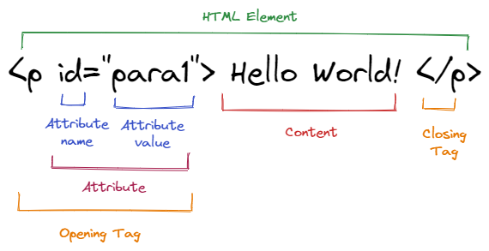
A <P> tag with attribute, value and content

Slide 3
Marquee and its attributes
Marquee and its attributes
A marquee is a block-level element that allow text or images scroll through our browser. *Although deprecated, but most recent browsers still supports its usage.
<marquee> I am scrolling </marquee>
<marquee behavior="scroll" direction="left" scrollamount="5"> This is a maquee </marquee>
We also have other behavior values such: slide, alternate,
QUIZ: Why will align not have visible effect on an inline element like span? *

Slide 4
HTML5 style attributes
Setting the style of an HTML element, can be done with the style attribute.
The HTML style attribute has the following syntax:
<tagname style="property:value;">
Other attributes are:
background-color
Color
Font-size px,%, pt rem, em
text-align
Font-family

Slide 5
Classwork: Design a web page for the opening of the letter below.
  SanerClimes Systems Ltd,
  Osolo way, opp Dominos
  Isolo, Lagos State.
  Dear Sir,
  APPLICATION FOR THE ROLE OF A PROGRAMMER
  Write 5 block-level elements in an Ordered list
  Write 5 Inline elements in an Unordered list
  Use a marquee to display “Thank You for accepting me”

Slide 6
HTML IMAGE TAG
The HTML image tag is a Self closing AND uses the src attribute.
Defined by the tag <img>, and the attribute src and alt, it does not have a closing tag. <img />
Attributes: width, height, alt (Hint width and height are in pixels or percentage, The src attribute contains a URL pointing to the image you want to embed in the page. )
<img src=“” />
Syntax:
<img src="url" alt="alternatetext">
<img src=“images/mydogpic.jpg" width="100" height="216" alt=“dog photo" />
If a browser cannot find an image, it will display the value of the alt attribute
The alt attribute also helps when displaying websites where pictures are turned off (maybe to save bandwidth)

Slide 7
HTML IMAGE
Images in another folder: expects to find in the same folder or sub folder, then specify the sub-folder name.
Images on another server: different from where your file is – specify absolute/full website address.
CLASS EXERCISE:
Update your personal web page assignment to include ‘Gallery’ section, use marquee to form the photo gallery of at least 4 images and set the scroll direction to left.

Slide 8
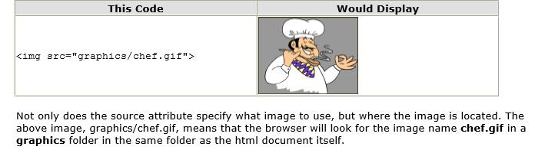
Specifying Image Location

Slide 9
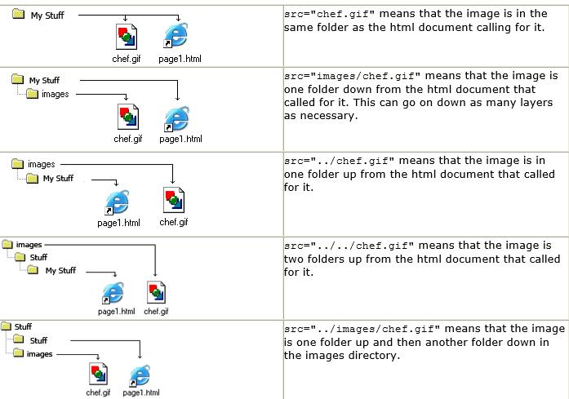
SPECIFYING IMAGE FILE PATH

Slide 10
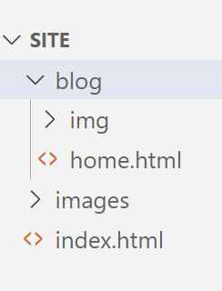
Exercise:
Using the given folder structure, create a site using images from the folders

Slide 11
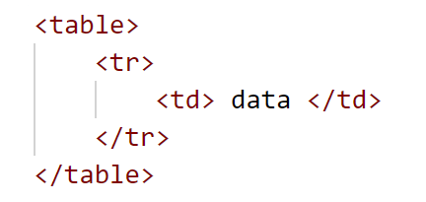
HTML TABLE
Sometimes in your web application, you need to create a table which holds data just as you have it in word processing documents:
A table is a structured set of data made up of rows and columns (tabular data).
A table allows you to quickly and easily look up values that indicate some kind of connection between different types of data.
It is a combination of nested tags

Slide 12
TABLE
An HTML table is defined with the <table> tag.
Each table row is defined with the <tr> tag.
A table header is defined with the <th> tag (instead of <td>). By default, table headings are bold and centered.
A table data/cell is defined with the <td> tag.
The <td> elements are the data containers of the table. Also, the numbers of td’s will determine the number of columns we will have
NOTE:
Contents can not be written in the <tr> or <table> tag directly!

Slide 13
An HTML tables allow web developers to arrange data into rows and columns.
The Table structure is well represented using the attribute ‘border” at the opening tag of the table.
<table border=“1”>
<tr>
<th>Company Name</th>
<th>Contact</th>
<th>City</th>
</tr>
<tr>
<td>Food Production</td>
<td>Maria Bolu</td>
<td>Ikeja</td>
</tr>
<tr>
<td>Livestock Production</td>
<td>Ayo Osa</td>
<td>Lekki</td>
</tr>
</table>

Slide 14
What it will look like:
Company Name | Contact | City
Food Production | Maria Bolu | Ikeja
Livestock Production | Ayo Osa | Lekki

Slide 15
HTML special entities, synmbols and characters
<p> This is a &lt; p &gt; </p>
<p>The none breaking space &nbsp; code</p>
<p>The naira sign &#8358; </p>
<p>The euro sign &#8364; </p>
<p>The cedi sign &#8373; </p>
<p>The Copyright sign &copy; or &#169; </p>
<p>The registered trademark sign &reg; </p>
<p>The fraction sign &frac12; or &#189;</p>
<p>The arrow down sign &#8595; </p>
<p>The arrow front sign &#8594; </p>
<p>The back arrow sign &#8592; </p>
<p>The up arrow &#8593; </p>
<p>The left-over-right arrow &#8646; </p>

Slide 16
Class Exercise:
Create a table of 3 rows and 3 columns.
Let the <th> be
S/N
Name
Photo
Insert any image in the photo column. Hint, remember nested tags.

Slide 17
ATTRIBUTES OF HTML TABLE, HEADING
You will notice that the width of the table and each <td> grows with the contents
The table element is somewhat rigid because the size of one <td> affects the other <td>s below and above it.
You can make use of the width attribute to control the size of the width;
Dimensions can be in px or %
Rather than using <td></td> for the heading, we can separate the look and feel of the headings by replacing <td> with <th>

Slide 18
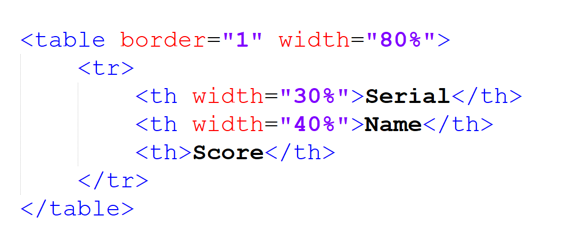
ATTRIBUTES OF HTML TABLE
Question: A table’s dimension has been specified in % as shown :
What will be the width of the ‘score’ column ?

Slide 19
ATTRIBUTES OF HTML TABLE
Other table attributes are: cellspacing, cellpadding, align (alignment per td), height, bgcolor(On any of the tags)
Cellspacing and Cellpadding: Applies only to the Table (not td)
Height: Applies only to the td. (Not the Table)
The frame attribute which also have values like; above, below, border, box. On the Table tag.
EXERCISE: Apply any of the above properties on the table you just created

Slide 20
Some Style Attributes of the HTML Table
border-collapse: collapse;
border: 1px solid black;
background-color: red;
color: white;

Slide 21
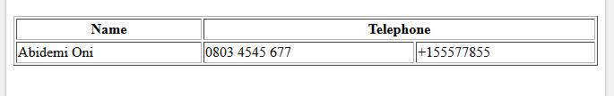
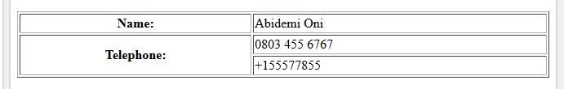
SPANNING TABLE ROWS AND COLUMNS
Understanding colspan
Understanding rowspan

Slide 22
COLSPAN: one occupying many spaces
<table border='1'>
<tr>
<th>Name</th>
<th colspan="2">Telephone</th>
</tr>
<tr>
<td>Abidemi Oni</td>
<td>0803 4545 677</td>
<td>+155577855</td>
</tr>
</table>

Slide 23
ROWSPAN: one occupying many spaces
<table border='1' width='100%'>
  <tr>
  <th>Name:</th>
  <td>Abidemi Oni</td>
  </tr>
  <tr>
  <th rowspan="2">Telephone:</th>
  <td>0803 455 6767</td>
  </tr>
  <tr>
  <td>+155577855</td>
  </tr>
</table>

Slide 24
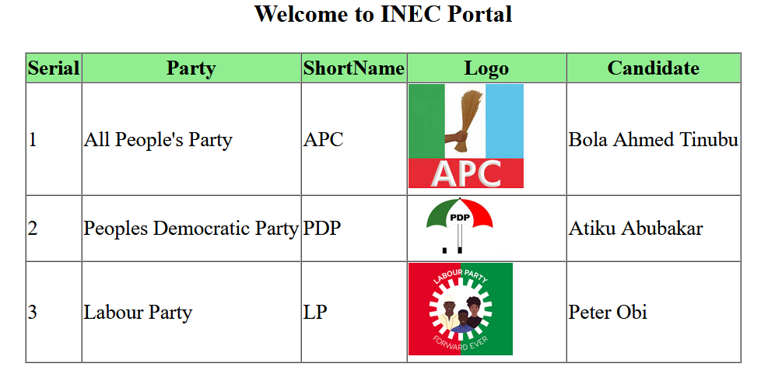
Exercise

Slide 25
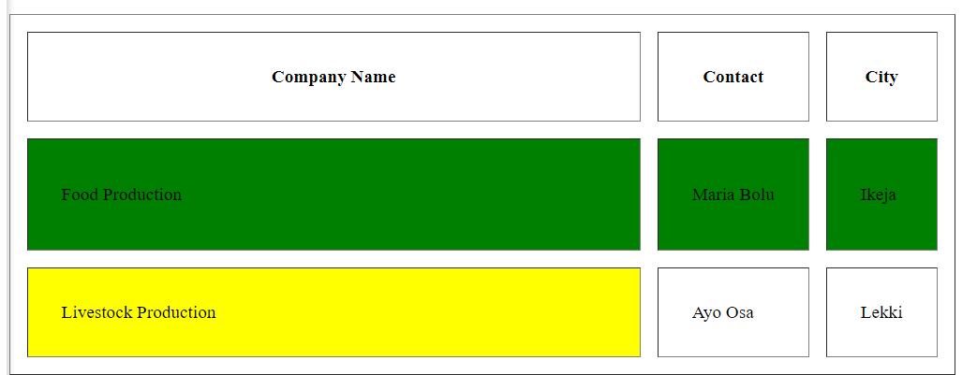
Assignment: Attempt the table design below

